Slide 1

Treatment of Other Financial Assistance (OFA)
Fall 2024

Slide 2
Definition of Other Financial Assistance
The definition of other financial assistance (OFA) in 24 CFR 684.102(b) states: “Estimated Financial Assistance: The estimated amount of assistance for a period of enrollment that a student (or a parent on behalf of the student) will receive Federal, State, institutional, or other resources such as scholarships, grants, net earnings from need-based employments or loans, including by not limited to- Any educational benefits paid because of enrollment in a postsecondary education institution, or to cover postsecondary education expenses. The assumption of this part of the definition is that the student would not be receiving the assistance if he/she was not enrolled at a postsecondary institution.
Notes:
Key points: bold text. If benefit received due to being a student 80% of the time, the aid will count as OFA. Period of Enrollment = is all encompassing to include entire enrollment/non enrollment period. It doesn’t matter what the conditions are and when received, department takes an all encompassing.

Slide 3
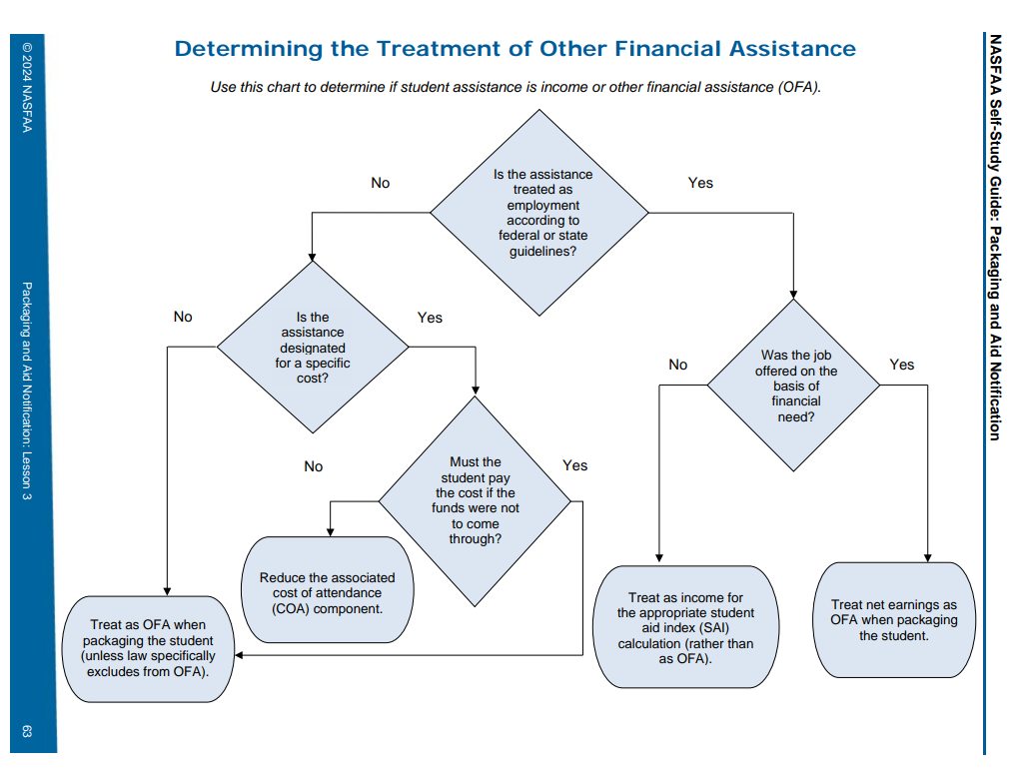
Notes:
Helpful tool to determine if assistance is employment or OFA. Need based employment may not always be work study, if it is need based, is considered OFA. Exclusions are VA benefits, 529 funds, etc..

Slide 4
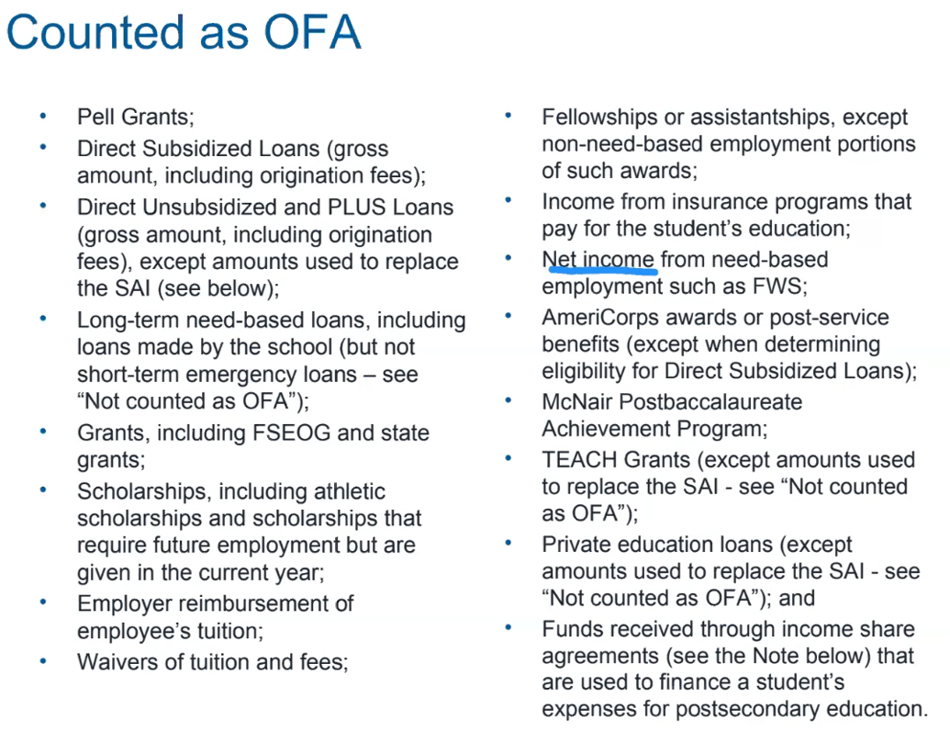
Notes:
Federal VA Benefits are excluded, Any non federal (state) are included as OFA

Slide 5
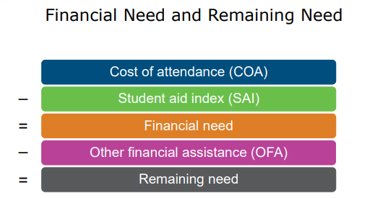
Accounting for Other Financial Resources

Slide 6
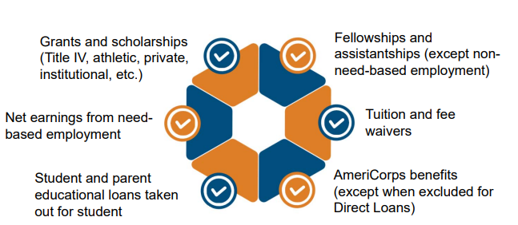
Other Financial Assistance(OFA) Includes but Is Not Limited to…….

Slide 7
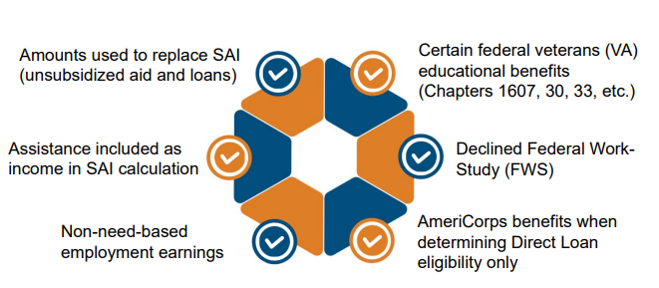
OFA Does Not Include……

Slide 8

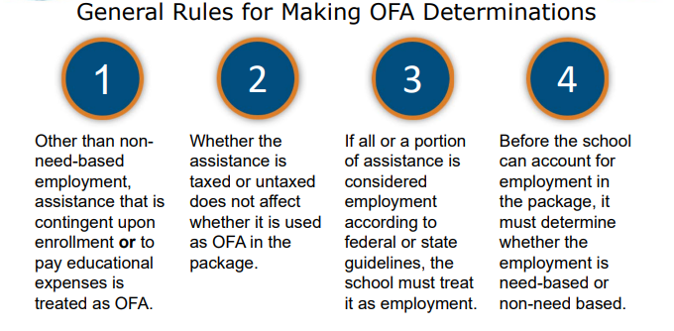

Slide 9
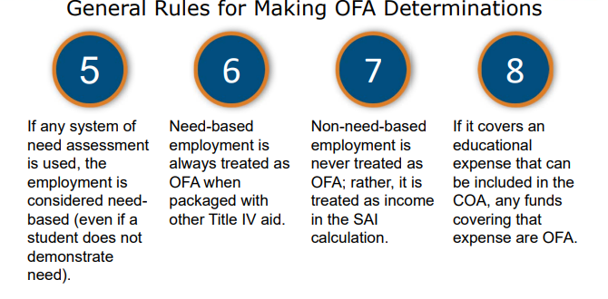

Slide 10
OFA Examples
Cash Gifts/Gift Cards
Conference Travel not required for student’s program.
Post Graduation Award
Non-monetary items that are tracked
Any funding received due to postsecondary enrollment.
Fellowships or assistantships

Slide 11
General Rules
Whether the amount or benefit is taxed or untaxed does not affect whether it is used as OFA in the financial aid package.
Other than non-need based employment, an amount or benefit that is contingent upon the student’s enrollment is generally treated as OFA, since it is probably going toward educational expenses.

Slide 12
General Rules
If a student receives an amount, benefit or need-based employment during a period of nonattendance, and those funds are provided to the student due to postsecondary enrollment, then those funds are OFA toward the upcoming period of enrollment.
There is no de minimus or minimum amount that would not have to be counted-any amount is OFA.

Slide 13
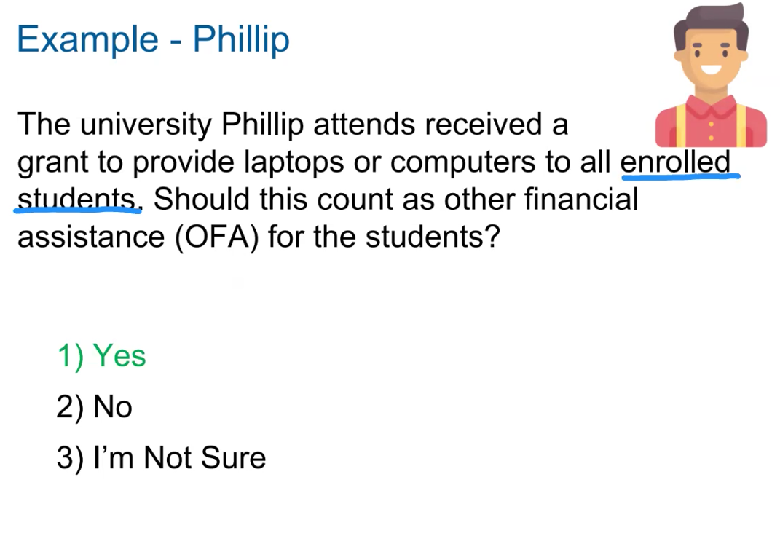

Slide 14
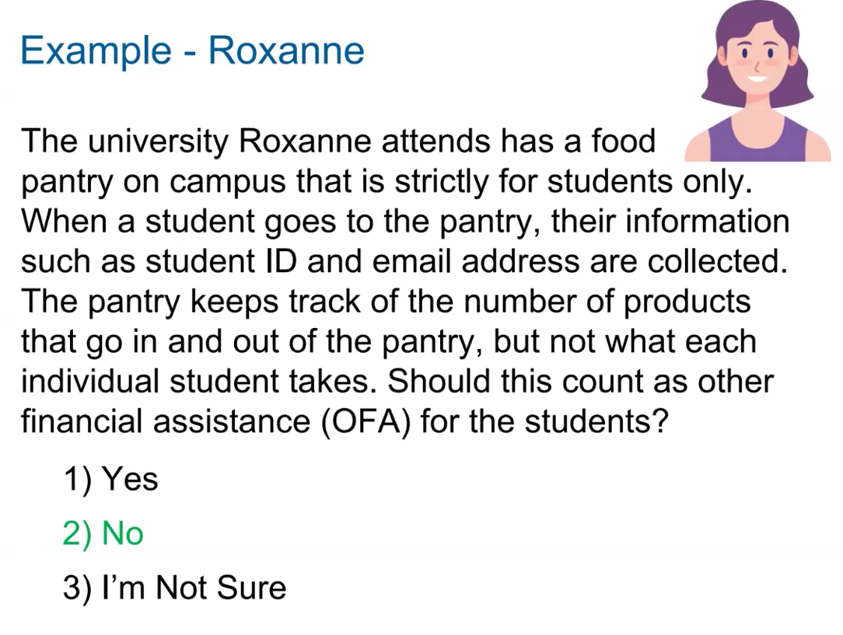
Notes:
Based on manner on how collected and distributed, this references in kind support which would not be untaxed income. If school is tracking and how much food, it would be OFA but because not inventorying what student is taking then not OFA.

Slide 15
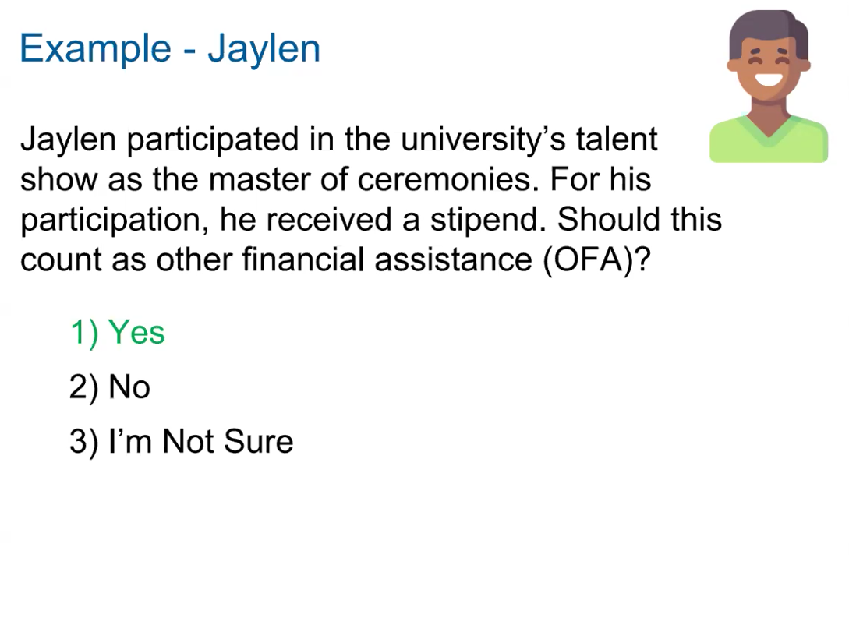
Notes:
There is no minimum amount. This is the university’s talent show.

Slide 16
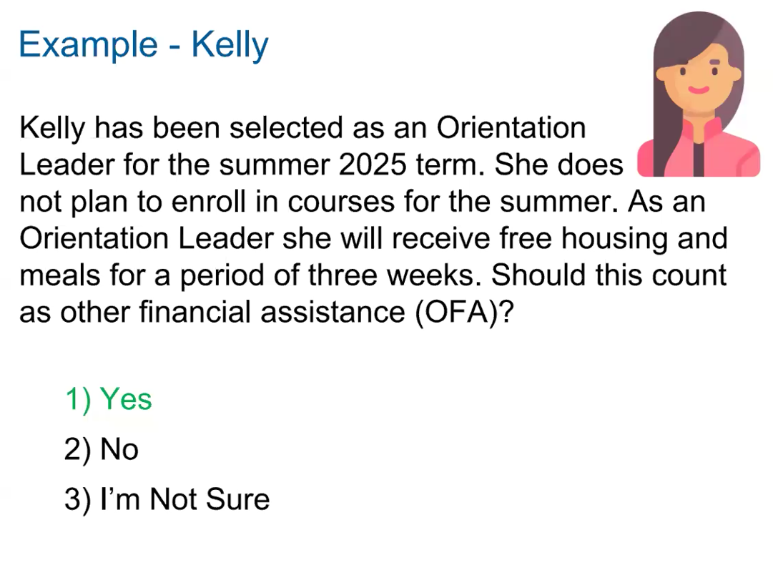
Notes:
Yes, this counts as OFA and would be accounted for in the fall because Kelly isn’t enrolled for summer. If Title IV aid, fully packaged, would have to reduce aid

Slide 17
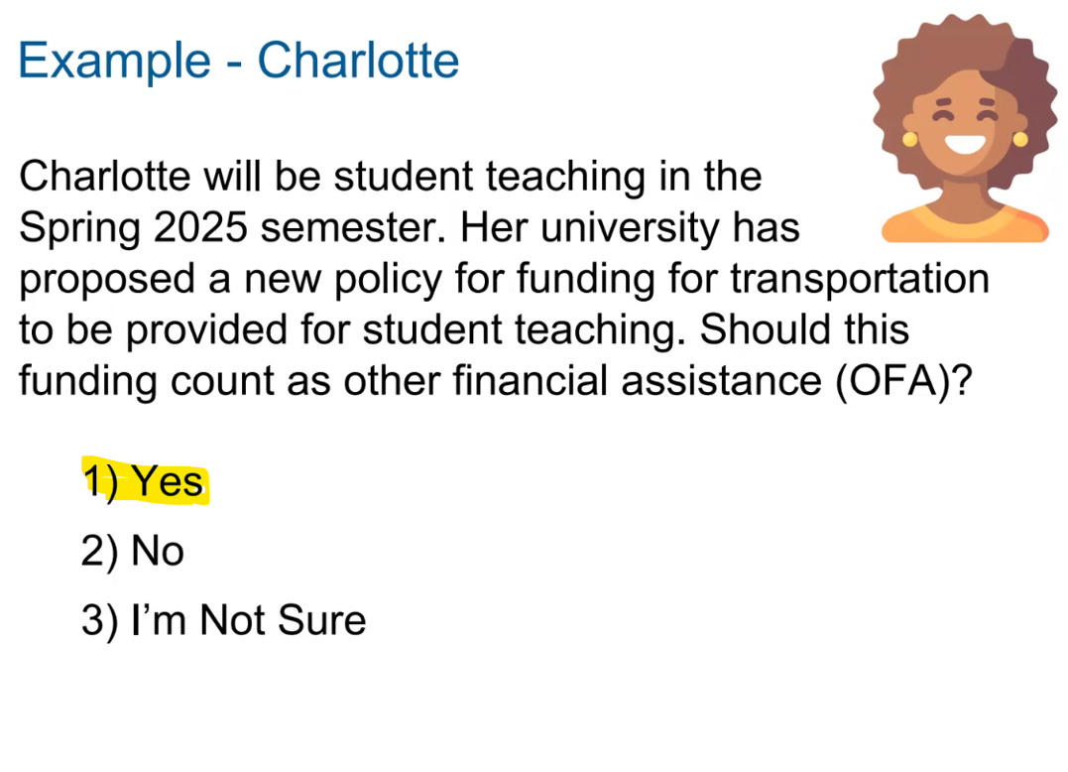
Notes:
Yes, this is based on student’s enrollment and she would accrue this cost.

Slide 18
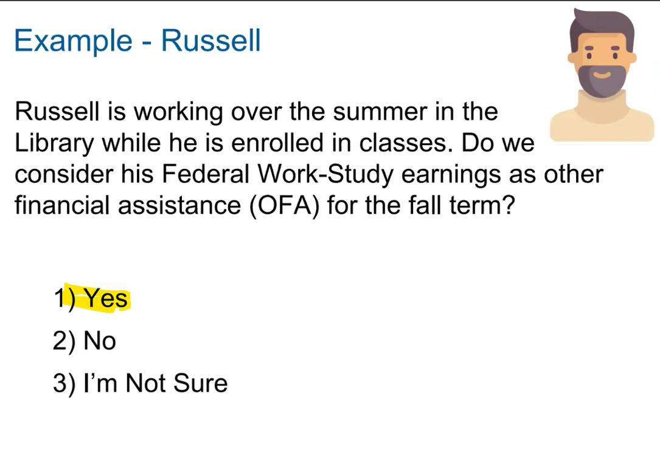
Notes:
No, the fund would be accounted for in the summer term as Russell is enrolled. If he was not, then the funds would be accounted for in the fall term.

Slide 19
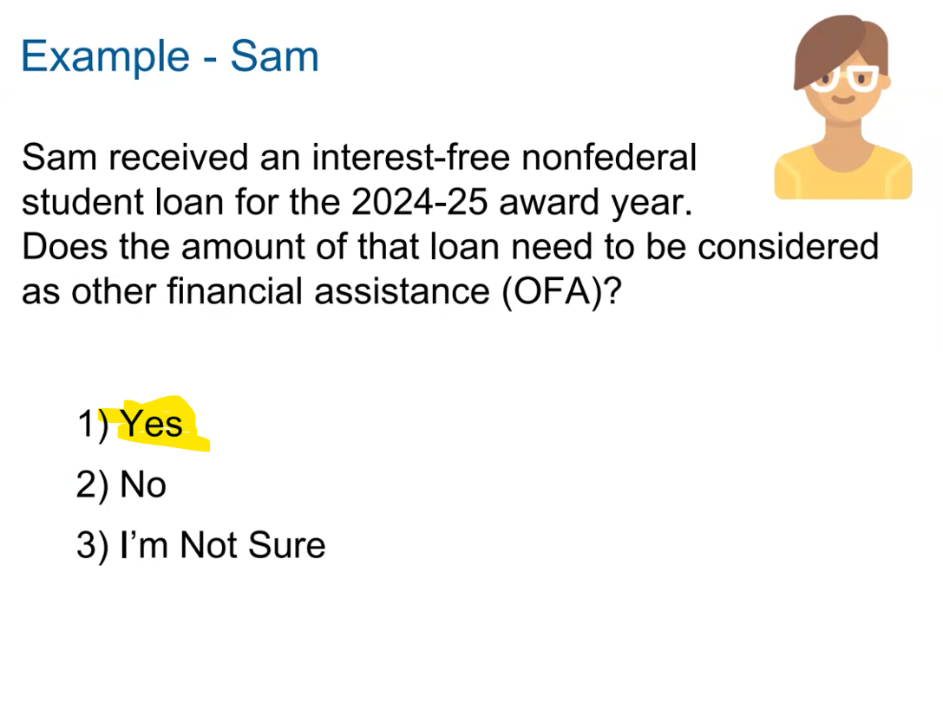
Notes:
Yes, if the funds are to not to be repaid during the award year.

Slide 20
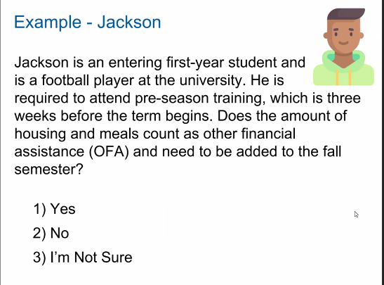
Yes, this is considered OFA. Cost for summer enrollment cannot be included in fall COA. If enrolled in the summer, funds would be OFA for summer.

Slide 21
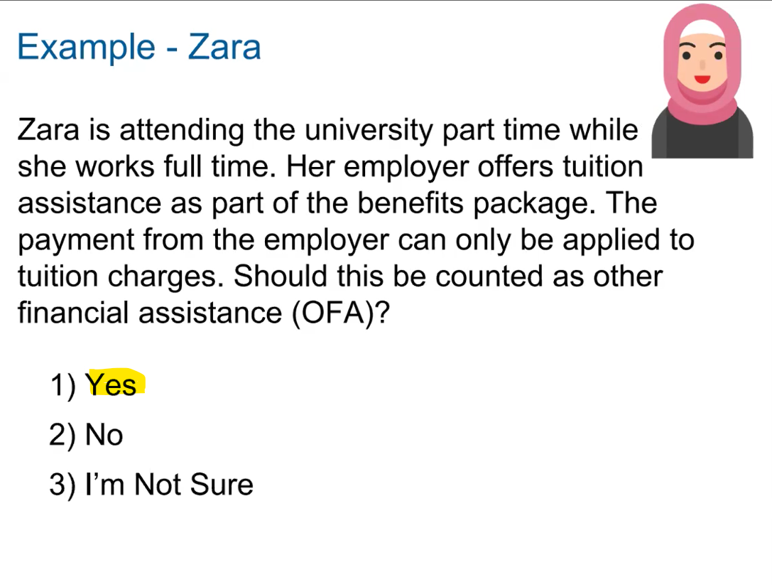
Notes:
Yes, this would count, if were income would not be considered a benefit.

Slide 22
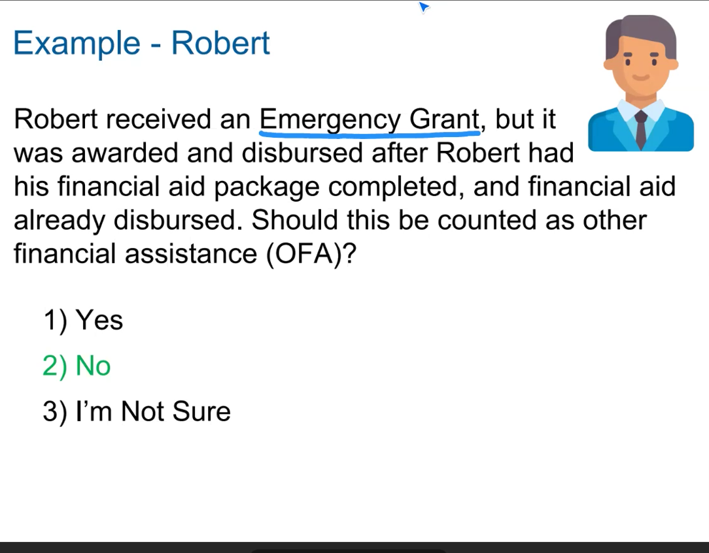
Notes:
No, it doesn’t matter of aid already disbursed or not, emergency aid is excluded as OFA. But definition of OFA is specific. (expenses included in COA must exist). Must be documented/retained. Passed due balance for tuition does not meet rules of emergency aid.

Slide 23
Emergency Aid
Emergency financial assistance includes any payment of grant or loan aid to a student for unexpected expenses that are included in one of the components of COA, as defined under HEA Sec. 472. For example, payments can support any unexpected expense for food; housing; course materials or equipment; or transportation (e.g., between campus and home for a death or family emergency). Institutions determine whether an unexpected expense is associated with a COA component.

Slide 24
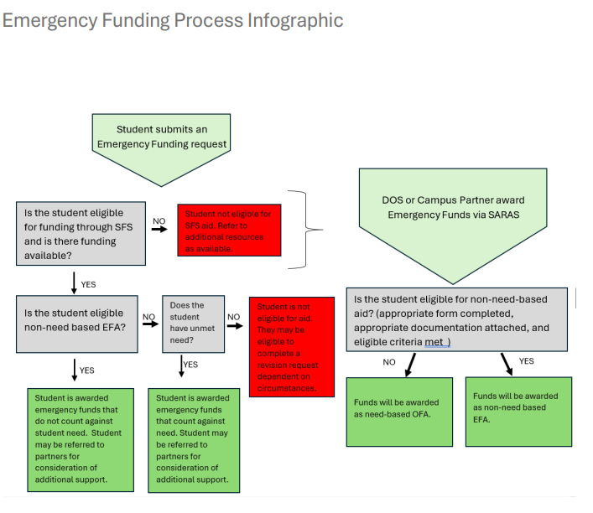
Notes:
Note that eligibility is also subject to funding availability

Slide 25
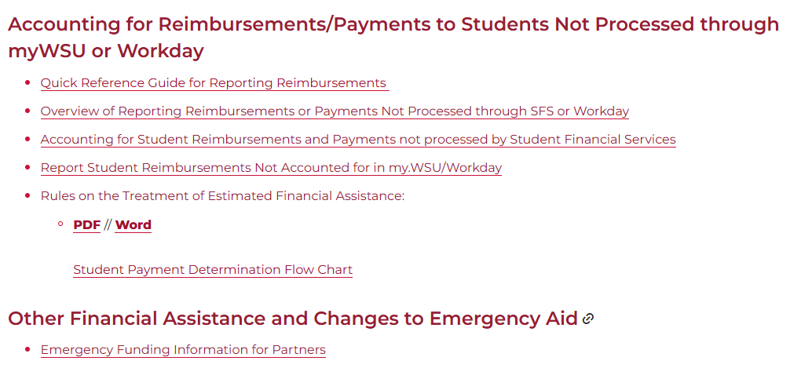
OFA & Emergency Aid Resources for Staff
SFS Campus Partner Portal: sfspartners.wsu.edu

Slide 26
Resources
SFS Website: finaid.wsu.edu
  Consumer Information & Policies
SFS Partner Portal: sfspartners.wsu.edu
SFS 411
SFS Staff Service Email: sfs.staffservice@wsu.edu
Contact Us
  509-335-9711
  https://financialaid.wsu.edu/contact/
  Sfs.compliance@wsu.edu

Slide 27

THANK YOU!

