Slide 1
Impact of the One Big Beautiful Bill Act (OBBBA) on Financial Aid for Grad & Professional Programs
by SFS
Notes:
Melissa - Disclaimer: This information is current as of today and may change.

Slide 2
Why This Matters for Graduate & Professional Programs
Graduate and professional students will experience significant financial aid changes.
Impacts borrowing limits, loan programs, and potentially enrollment and retention.
Leadership engagement is essential to guide strategic and student-focused responses.
Notes:
Melissa - The OBBBA has significant financial aid changes that will impact borrowing limits, loan programs, and potentially enrollment and retention.

Slide 3
Institutional Challenges
Reduced borrowing limits may constrain enrollment and access.
Increased demand for institutional aid, external scholarships, and private student loans.
Necessity for enhanced advising and cost transparency.
Notes:
Melissa – Currently anticipated institutional challenges from OBBBA: 1. Reduced borrowing limits may constrain enrollment and access to certain student populations. 2. An increased demand for other aid options. 3. The necessity for enhanced advising and cost transparency.

Slide 4
Key Timeline & Effective Dates
Signed into law: July 4, 2025
Effective date for new aid rules: July 1, 2026
Final regulation language due: June 30, 2026
Grandfather provisions for current borrowers enrolled prior to July 1, 2026, and actively borrowing
Negotiated Rulemaking Sessions concluded on November 6th
Regulation specific language will be open for public comment and finalized at a later date
Notes:
Melissa -

Slide 5
Summary of Major Financial Aid Changes
New annual and lifetime borrowing caps
Elimination of Graduate PLUS Loans
Prorated limits for less than full time enrollment
Definition of Professional student
Institutional accountability
New repayment options replacing current IDR (Income Driven Repayment) plans
Notes:
Melissa -

Slide 6
Regulatory Changes
Effective July 1, 2026
Notes:
Anthony

Slide 7
Graduate and Professional Unsubsidized Loan Limits
Impacted Students: GRAD and Professional
Rule | Before July 1, 2026 | As of July 1, 2026
Annual Limit | GRAD/BUSN: $20,500 Professional: $40,500 or $46,667 | GRAD/BUSN: $20,500 Professional: $50,000
Aggregate Limit | GRAD/BUSN: $138,500 Professional: $224,000 | GRAD/BUSN: $100,000 Professional: $200,000
Future Eligibility | Eligibility can be regained by paying down principal, cancelling the loan, or having your loan forgiven. | Eligibility cannot be regained.
Undergrad Borrowing | Included in lifetime calculation. | Not included in aggregate calculation. Lifetime Borrowing limit $257,500
*Undergraduate borrower changes are not addressed in this slide.
Notes:
Anthony
Let's talk first about unsubsidized loan borrowing for GRAD and BUSN. They have an annual borrowing limit of $20,500 and an aggregate borrowing limit of $138,500. That aggregate amount (1) does include borrowing that occurred as an undergraduate and (2) if you paid down on a loan your eligibility returned to borrow more in the future. Under the new rules GRAD and BUSN students now have (1) an aggregate limit is now $100,000, but the annual borrowing limit remained the same, (2) the new aggregate borrowing calculation does not include borrowing that occurred as an undergraduate student, (3) you cannot pay back your loan and get your lifetime eligibility back, and (4) if you've borrowed as a professional student and the amount is greater than $100,000 then you don't have any remaining eligibility.
Next, professional students that are not BUSN students. At WSU this includes MEDS, VETM, and PHAR students. Under the current rules (1) there is an aggregate borrowing limit of $224,000, (2) there is an annual borrowing limit of $40,500 for borrowers in a 9 month program or $46,67 in a 12 month program. There are special rules for students enrolled in 10 or 11 month programs, (3) borrowing that occurred as an undergraduate counts against the aggregate, and (4) you can regain aggregate eligibility by repaying loans. The new rules will set the aggregate borrowing limit to $200,000 per student, $50,000 per year, will not include borrowing that occurred as an undergraduate, and you cannot gain eligibility back regardless of whether the loan was repaid, forgiven, cancelled, or discharged.
Slide original text
Graduate (non-professional): $20,500 annual / $100,000
aggregate
Professional degree $50,000 annual / $200,000 aggregate
Lifetime cap for all borrowers (without regard to canceled/paid
off): $257,500

Slide 8
Elimination of Graduate PLUS Loans
Impacted Students: GRAD and Professional
Effective July 1, 2026, Graduate PLUS Loans will no longer be available to new borrowers.
Institutions may need to identify alternative funding sources and increase financial literacy efforts.
Greater reliance on scholarships, stipends, and private lending.
Notes:
Anthony
Which leads to our next change in the Big Beautiful Bill Act. The elimination of the Graduate PLUS loan program has been a very important part of funding for graduate students at WSU. In the last six years roughly 20% of graduate and professional students have borrowed Grad PLUS loans and a higher and higher percentage of Graduate students were borrowing Grad PLUS loans. More than half MEDS students offered Grad PLUS loans accepted the loan.
Financial aid alternatives to the GRAD PLUS loan program include Private Education Loans and Personal Loans.

Slide 9
Transition Period & Grandfathering
Impacted Students: Established Borrowers
Students with loans prior to July 1, 2026, may continue under old borrowing limits up to three years or until program completion (whichever is less).
Important for enrollment management and communication planning.
Overlapping cohorts will require clear guidance from financial aid offices.
An established borrower loses grandfathered access rights to the pre-July 1, 2026, borrowing rules if they do any of the following:
Change programs (limited exception)
Take a Leave of Absence (very limited exception)
Fail to graduate before their expected graduation timeline
Notes:
Anthony
For existing borrowers, they'll be able to continue to access the same loan programs and borrow under the same rules. If they change their course of study, any new borrowing takes place under the new rules after July 1, 2026.

Slide 10
Important Terminology
Established Borrower: A student who has borrowed student loans before July 1, 2026, or had loans borrowed on their behalf.
New Borrower: A student who has not borrowed student loans before July 1, 2026, or had loans borrowed on their behalf.
Notes:
Anthony
Loan proration impacts the annual loan limit and that impact will be seen in the term loan limits, too. For Grad and most professional students full time enrollment is considered 10 credits per term. If they're enrolled in 10 credits per term, the student won't see a decrease in their annual loan limit. LTFT loan proration is a complex and individualized process and cannot be fully explained, but simply put, if a student has less than full time credits they're eligible for less than full time funding. It's not fully understood how this will be implemented.

Slide 11
Professional Student
Impacted Students: DVM, MD, PharmD, DNP
Proposed Definition:
"Professional student: A student enrolled in a program of study that awards a professional degree upon completion of the program;
(1) A professional degree is a degree that:
(i) Signifies both completion of the academic requirements for beginning practice in a given profession, and a level of professional skill beyond that normally required for a bachelor's degree;
(ii) Is generally at the doctoral level, and that requires at least six academic years of postsecondary education coursework for completion, including at least two years of post-baccalaureate level coursework;
(iii) Generally requires professional licensure to begin practice; and
(iv) Includes a four-digit program CIP code, as assigned by the institution or determined by the Secretary, in the same intermediate group as the fields listed in paragraph (2)(i) of this definition.
(2) A professional degree may be awarded in the following fields:
(i) Pharmacy (Pharm.D.), Dentistry (D.D.S. or D.M.D.), Veterinary Medicine (D.V.M.), Chiropractic (D.C. or D.C.M.), Law (L.L.B. or J.D.), Medicine (M.D.), Optometry (O.D.), Osteopathic Medicine (D.O.), Podiatry (D.P.M., D.P., or Pod.D.), Theology (M.Div., or M.H.L.), and Clinical Psychology (Psy.D. or Ph.D.).
(3) A professional student under this definition:
(i) May not receive title IV aid as an undergraduate student for the same period of enrollment; and
(ii) Must be enrolled in a program leading to a professional degree under paragraph (2) of this definition."
Notes:
Melissa
Give a moment to read the proposed definition that will be available for public comment. 44 Unique 6-digit CIP codes fall under the same intermediate group under the programs in section 2.

Slide 12
Nursing - DNP
According to the proposed definition of "Professional Student" by the Department of Education, the Doctor of Nursing Practice is not considered a professional program and is subject to graduate borrowing limits.
This does not mean that the DNP program is no longer considered a professional program by academic standards.
Notes:
Melissa – Nursing DNP program is no longer classified as a Professional Level Program by the department of education and will be subject to the graduate loan limit of $20,500 annually and $100,000 aggregate.

Slide 13
Institutional Accountability
A new accountability measure that will cause a program to lose Direct Loan eligibility if it fails the "low earnings outcomes".
Compares the median earnings 4 years post-enrollment with the earnings of "working adults" with only a bachelor's degree who are not enrolled in higher education.
Warnings to students must be provided if a program fails.
Notes:
Melissa – A new accountability measure that will cause a program to lose Direct Loan eligibility if it fails the "low earnings outcomes" measure two out of three years. Compares the median earnings 4 years post-enrollment with the earnings of "working adults" with only a bachelor's degree who are not enrolled in higher education. Warnings to students must be provided if a program fails the "low earnings outcomes" measure. A New Earnings Indicator to Support Students and Families in Making Informed College Decisions is now included on the FAFSA.

Slide 14
Loan Proration
Effective for academic year 2026-2027, all federal student loans will be prorated based on enrollment intensity.
Full time Enrollment:
Graduate/Professional: 10 credit hours per term
MBA: 5 credit hours per term
Notes:
Anthony
Loan proration will impact all direct loans starting academic year 2026-2027, regardless of whether they are legacy or new borrowers. Enrollment intensity is calculated on a per term basis and annual basis. Full time enrollment intensity for graduate/professional students is at 10 credits. For MBA students full time enrollment intensity is established at 5 or more credits. There are loan provisions that are not impacted by this, so a student enrolled in less than half time intensity is not eligible for student loans. So this loan proration will only impact students enrolled in less than full time and more than half time enrollment intensity. On the next slide we'll go over the proration schedules for the different academic careers and their impact on their annual loan limits based on their enrollment intensity.

Slide 15
Loan Proration Schedule (Graduate & Professional)
Impacted Students: All students
Number of Credits per Term | Percent of Eligibility | Grad Annual Loan Limit | Professional Annual Loan Limit
10+ | 100% | $20,500 | $50,000
9 | 90% | $18,540 | $45,000
8 | 80% | $16,400 | $40,000
7 | 70% | $14,350 | $35,000
6 | 60% | $12,300 | $30,000
5 | 50% | $10,250 | $25,000
Less than 5 | 0% | Not eligible | Not Eligible
*Undergraduate borrower changes are not addressed in this slide.
Notes:
Anthony
Loan proration impacts the annual loan limit and that impact will be seen in the term loan limits, too. For Grad and most professional students full time enrollment is considered 10 credits per term. If they're enrolled in 10 credits per term, the student won't see a decrease in their annual loan limit. LTFT loan proration is a complex and individualized process and cannot be fully explained, but simply put, if a student has less than full time credits they're eligible for less than full time funding. It's not fully understood how this will be implemented.

Slide 16
Loan Proration Schedule (MBA)
Impacted Students: MBA students
Requires institutions to prorate annual loan limits for less than full time enrollment.
Number of Credits per Term | Percent of Eligibility | BUSN Annual Loan Limit
5+ | 100% | $20,500
4 | 80% | $16,400
3 | 60% | $12,300
Less than 3 | Not Eligible | Not Eligible
Notes:
Anthony
Loan proration impacts the annual loan limit and that impact will be seen in the term loan limits, too. For Grad and most professional students full time enrollment is considered 10 credits per term. If they're enrolled in 10 credits per term, the student won't see a decrease in their annual loan limit. LTFT loan proration is a complex and individualized process and cannot be fully explained, but simply put, if a student has less than full time credits they're eligible for less than full time funding. It's not fully understood how this will be implemented.

Slide 17
Funding Gap & Historical Borrowing

Slide 18
Funding Gaps:
Due to:
Changes to annual and aggregate borrowing limits
Enrollment intensity loan proration
Discontinuation of Grad PLUS loan program
Notes:
Anthony - Students will have to rely on other options to fund their education; scholarships, outside grants, private student loans, etc.

Slide 19
Funding Gap Case Example: Professional Student Impact
Example: Butch Cougar Student (MED 4-year program)
COA: $75,000/year → $300,000 total
Borrowing limit: $50,000/year → $200,000 total
Lifetime cap: $200,000
Result: $100,000 gap over program duration ($25,000 gap per academic year) may require alternative funding or personal resources.
Notes:
Anthony
Here's an example of how that can impact a student. Here we have J.D. student paying $75,000 per year for four years to graduate as an MD. He borrows the full amount he's eligible for every year, which is $50,000. Each year J.D. needs to find an additional $25,000 in funding to pay for his degree. By the time he graduates he'll have needed to find another $100,000 in funding to pay for college. Under the prior rules he could have borrowed a Grad PLUS loan each year to make up the difference.

Slide 20
Grad PLUS Loans Borrowed by Academic Career
Award Year | 2020-2021 | 2021-2022 | 2022-2023 | 2023-2024 | 2024-2025
BUSN | 4.1% | 4.4% | 4.6% | 4.3% | 3.8%
GRAD | 4.9% | 4.8% | 4.5% | 5.8% | 5.5%
MEDS | 2.1% | 2.7% | 3.6% | 4.1% | 4.5%
PHAR | 5.1% | 4.5% | 3.8% | 3.3% | 3.0%
VETM | 1.8% | 2.0% | 2.3% | 3.0% | 3.2%
Total Overall | 18.0% | 18.5% | 18.8% | 20.4% | 20.0%
*Award Year Includes: Fall, Winter*, Spring, Summer
Notes:
Anthony
This table shows the percent of grad and professional students that accepted Graduate PLUS loans by academic career and by year.

Slide 21
Challenges and Risks
Funding gaps for high-cost programs
Student financial insecurity, confusion and misinformation
Potential enrollment decline in certain disciplines
Increased administrative complexity for aid offices
Compounding risk with assistantships with decreasing availability
Notes:
Melissa

Slide 22
Next Steps
1. Map all professional and graduate programs to determine applicable borrowing category (SFS)
2. Develop communication new and continuing students (SFS)
3. Review institutional aid strategy and scholarship alignment
4. Establish financial aid packaging guidelines for 2026-2027 (SFS)
Notes:
Melissa

Slide 23
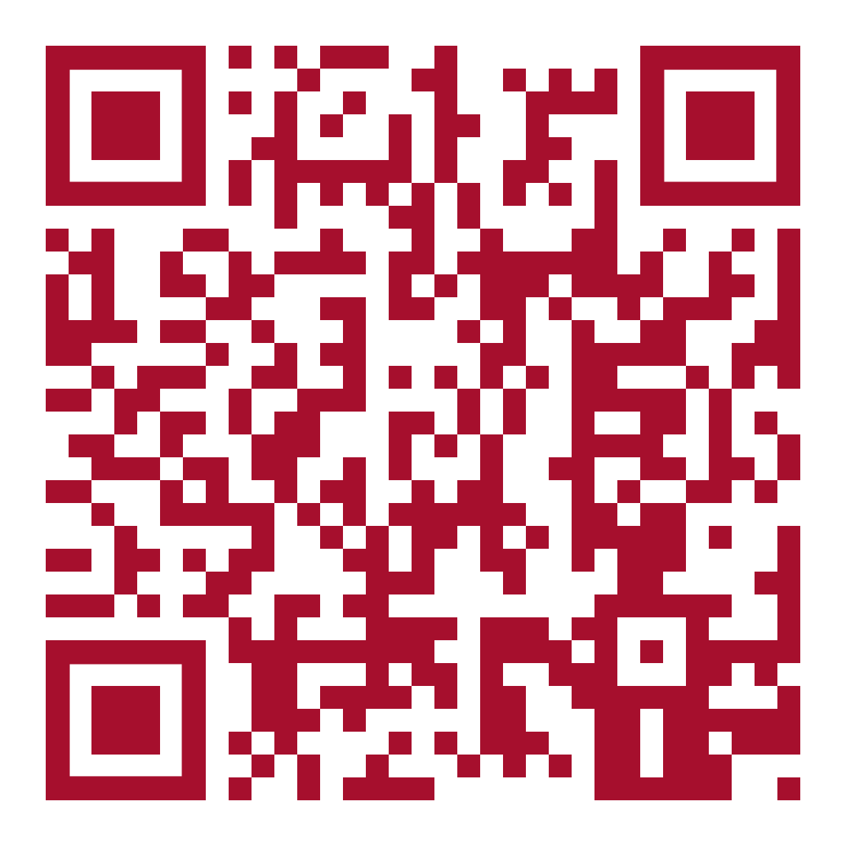
Summary & Key Takeaways
Major shift in federal aid policy affecting graduate and professional programs.
Leadership alignment and planning are critical.
Early action ensures institutional readiness and continued student access to aid.
Possible enrollment impact.
Economic pressure to low-resourced students.
SFS Partner Portal: draft analysis of loan impact and info: https://sfspartners.wsu.edu/one-big-beautiful-bill-act/
SFS Info Link: https://financialaid.wsu.edu/2025/11/10/one-big-beautiful-bill-act-2026-27-changes-to-federal-financial-aid/
Notes:
Melissa

Slide 24
Questions & Discussion
Topics to consider:
Student communication
Institutional coordination
Alternative funding solutions
3rd Party Private Loan Agent Contracting?
Strategic Opportunities – Ideas??
Expand partnerships for private financing with student protections
Increase fundraising for professional student scholarships
Integrate financial literacy modules into program onboarding
Leverage WSU system data to demonstrate professional program outcomes
Notes:
Melissa

